Slide 1


ABAP on Hana s/4 Hana Training
Day 11
contact@anubhavtrainings.com

Slide 2

Agenda – Day 11
Introduction of CDS(Core Data & Service )
Concept of CDS View
Describing Standard CDS View
Understanding Concept of Code to Data Paradigm
Creating CDS Entities

Slide 3

Introduction to Core Data & Services
CDS stands for Core Data Services. This is the new programming paradigm within new SAP environment specifically S/4HANA systems. So CDS views are the new programming design concepts which can achieve Code-to-Data paradigm which actually means Code push down into the database for processing.

Slide 4
Core Data & Services at Glance
1
4
Semantically Rich Data-Models
Domain specific languages (DDL, QL, DCL)
Declarative, close to conceptual thinking
Common Basis for Domain-Specific Frameworks e.g. UI, Analytics, OData, BW,…
@AnalyticsDetails.aggregationBehaviour: SUM
2
5
CDS is completely based on SQL
Any ‘Standard SQL’ features directly available like joins, unions, build-in functions, …
Built-in Functions and Code Pushdown
Table Functions for Breakout Scenarios
Rich Set of Built-in SQL Functions
3
6
Fully Compatible with Any DB
Generated and managed SQL Views
Modern Open SQL
Extensible
On model level thru extensions
On meta-model level thru annotations

Slide 5

Concept of CDS
Can I develop CDS views if my Company is not on HANA?
Yes, Provided your ABAP system is above NW 7.4 SP6 +.
You may not get the full potential as you may get when you are on HANA.
Are CDS views same as HANA Calculation Views?
No. HANA Calc view created in HANA Directly, But CDS views are created in ABAP.
When you activate it generate Runtime object which is a HANA View inside of HANA.
Which system do I code cds views.
ABAP system only using ADT
Which is the best way and best practice to implement the CDS views? Are there some guidelines on CDS views for S/4HANA?
You can get good performance with CDS views, there are guidelines which we can use like VDM
I have heard about HANA CDS views also, are these same?
No. ABAP CDS and HANA CDS are one concept but 2 flavor.
HANA CDS is used in companies who buys HANA only, they don’t have ABAP system. https://www.youtube.com/watch?v=rTsAg_OGh-A

Slide 6
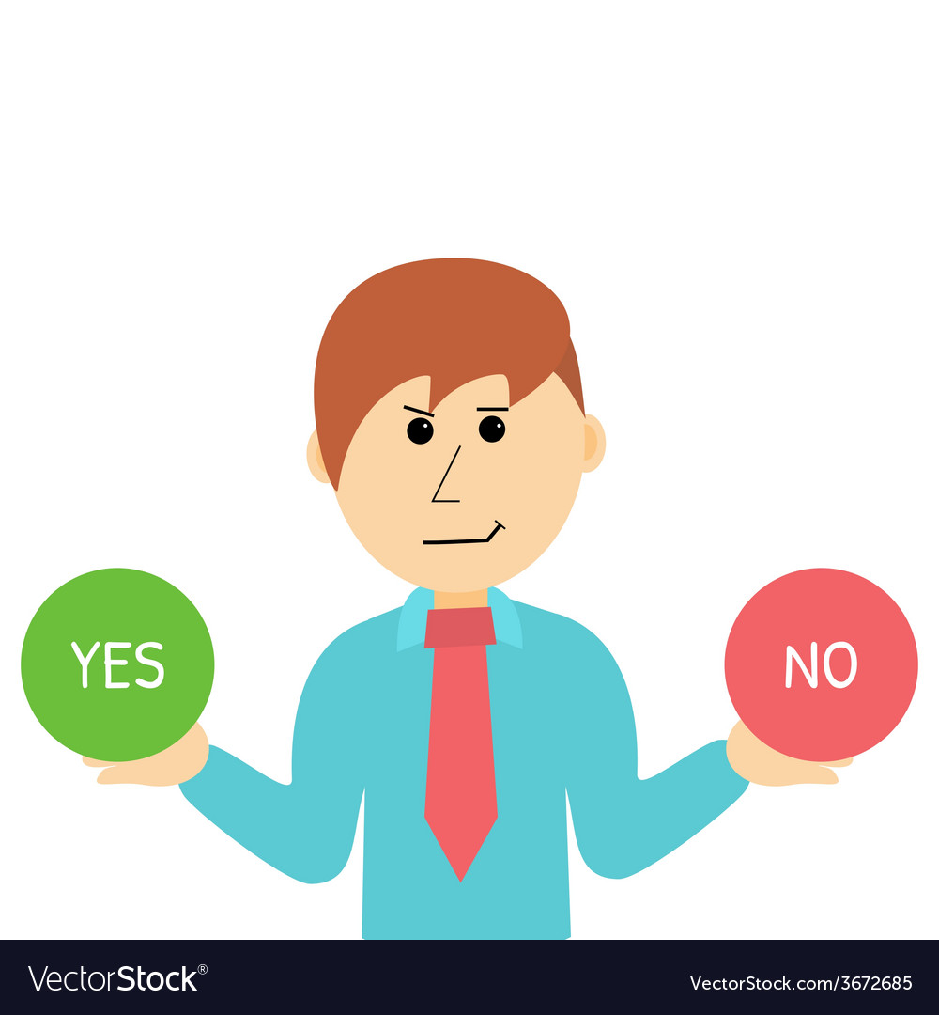
Concept of CDS
If I am not from ABAP Background, do I need to learn ABAP to code CDS Views?
From here, CDS is completely new syntax.
Can I also create new DB Table using CDS, or is it only for Views?
Yes, indeed if you learn ABAP on Cloud, perhaps this is the only way to create table in ABAP on Cloud System.
Can we update data also from CDS views or is it only View data.
No. But when this concept is combined with frameworks like BOPF and RAP. Here CDS will work like template/data structure/BO to tell the framework what kind of data to work.
Can Fiori App Call CDS view directly
No. FIORI ONLY AND ONLY TALKS TO ODATA
Can BO Reporting tool consume CDS views?
Yes, even SAP Analytics Cloud.
What is VDM, we hear this term a lot?
Virtual Data Modeling, This is a gold standard to build views in SAP S/4HANA.

Slide 7

Concept of CDS
Can we pass parameters to CDS, is there any way I can pass SELECT-OPTIONS also
We can pass parameter, we cant code SELECT-OPTION directly.
Can I call SQL Script code in CDS, Or can I call AMDP in CDS..
Yes, we have starring NW 7.5 a new option which called CDS table function.
How do we secure Data using CDS views
CDS DCL concept.
Can I extend a SAP Delivered CDS view?
Yes, we have CDS Extension concept.
Where can I find the list of All the SAP Delivered CDS views in S/4HANA.
https://api.sap.com/themes/CDSViews
I hear a term called CDS Entity, SAP says that this will overwrite CDS views. Is it true?
Yes.

Slide 8

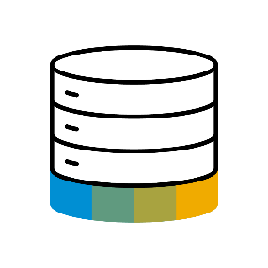
Paradigm Changes in Application Programming
Data-to-Code Intensive computations in APPLICATION layer
Application Programming Models
Classic Approach
Data Centric Approach
Database
Code-to-Data Intensive computations in DATABASE layer

Slide 9
A Family of Domain Specific Language
functions
functions
DDL
Define authorizations for DDL views
Modelled and declarative approach
Integrates with classic authorization concepts
DCL
Data modelling and retrieval on a higher semantic level
Extends native SQL leads to higher productivity
Data Definition Language
Query Language
Data Control Language
functions
QL
Consume CDS entities via Open SQL in ABAP
Fully transparent SQL extensions

Slide 10
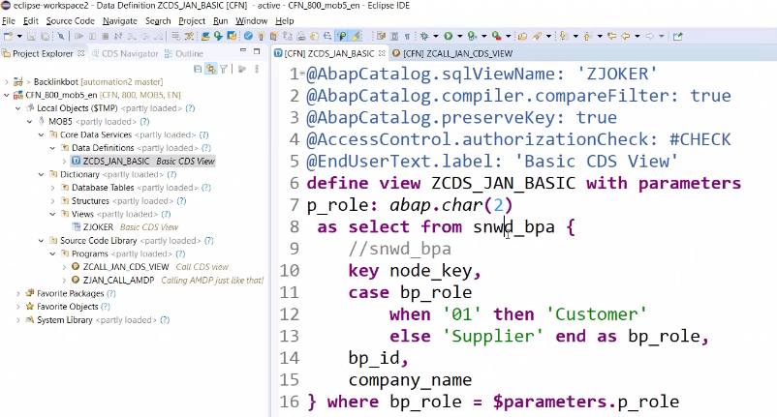
Creating CDS View
Create Basic CDS View with parameter and Data Expose from snwd_bpa (Business Partner Table) .

Slide 11
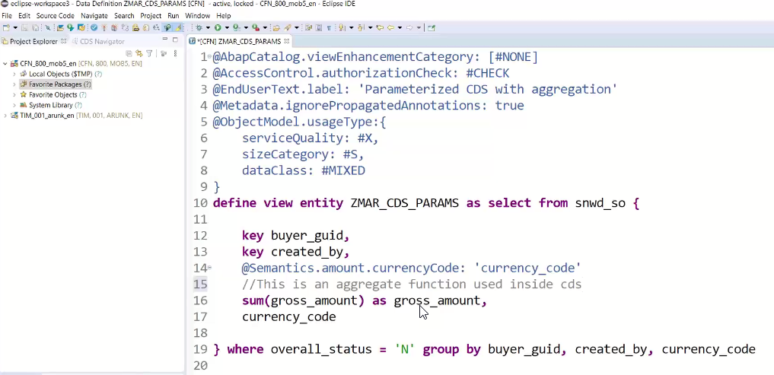
Core Data & Service Entities
A CDS entity has a specified number of columns, defined at the time of entity creation, but can have any number of rows. Database entities also typically have meta-data associated with them; the meta-data might include constraints on the entity or on the values within particular columns. SAP HANA Extended Application Services (SAP HANA XS) enables you to create a database entity as a design-time file in the repository. All repository files including your entity definition can be transported to other SAP HANA systems, for example, in a delivery unit. You can define the entity using CDS-compliant DDL.

Slide 12

Exercise
Basics of CDS View & CDS Entities Code

Slide 13

End of Day 11
Trainer: Anubhav Oberoy

Slide 14

Trainer: Anubhav Oberoy

Slide 15
THANK YOU
If you cannot do
great things, do small things in a great way.
Anubhav Oberoy
https://www.anubhavtrainings.com

Slide 16


We’re committed to empower you to be
Most Desirable Resource
through powerful training solutions.
We build the workforce of the future.
250+
Corporate Clients
30,000+
Learners Trained
25000+
Learners Placed
FREE WEBINARS
Sign up for free webinars with industry experts every fortnight!
Enroll Now!
Contact us today!
https://anubhavtrainings.com/

Slide 17




More from AnubhavTrainings.com

